Slide 1
FIFA 18: Predicting Player’s Wages
Ahmad, Beka, and Rafael

Slide 2
FIFA 18: Predicting Player’s Wages
By using a dataset of Players’ attributes from FIFA 18, a video game developed by EA, our objective is to illustrate the linear regressions methods taught in the MATH-327 Course.
The Research Questions we aim to answer are:
What set of a player’s attributes best predict a player’s wages?
How precise are those predictions?

Slide 3
Response and Predictor Variables
Response variable
Wage - Euros
Predictor Variables
Age - Age of player in years
Overall - Overall rating of player from 0 - 99
Potential - Highest Overall rating that player can achieve from 0 - 99
Value - Estimated value of player in the market in Euros
Special - Sum of athletic attributes minus Composure (psychological)
Reactions - Estimated value of player’s reaction to a play. From 0 - 99.
Preferred Positions - Position on the pitch where the players performs best.
Striker -> ST, CF, RF, LF
Winger -> RW, LW
AttMid -> CAM, CM, RM, LM, RAM, LAM
DefMid -> CDM, RDM, LDM
CenterBack -> CB, RCB, LCB
WingBack -> LWB, RWB, LB, RB
There are 975 players in the data set

Slide 4
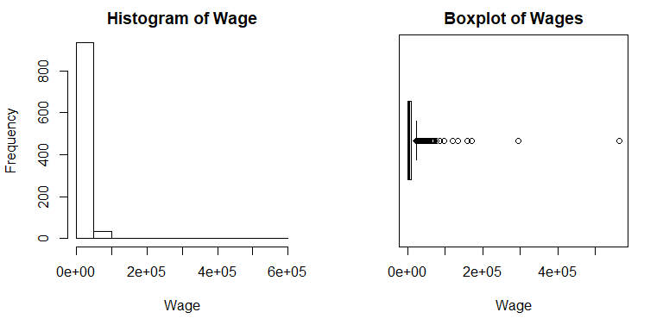
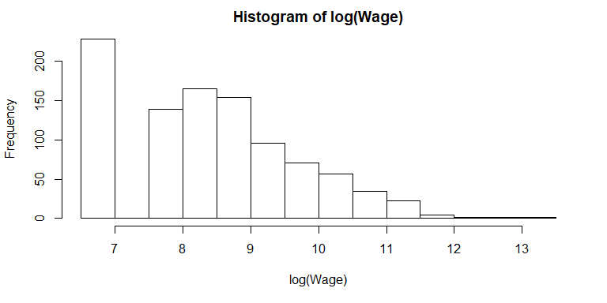
Histogram of Wage vs Histogram of log(Wage)
Distribution is extremely right skewed, while the distribution of Log Wage is more symmetric although still moderately right skewed.
The predictor variable: Value, also needed a log transformation as shown in the next slide.

Slide 5
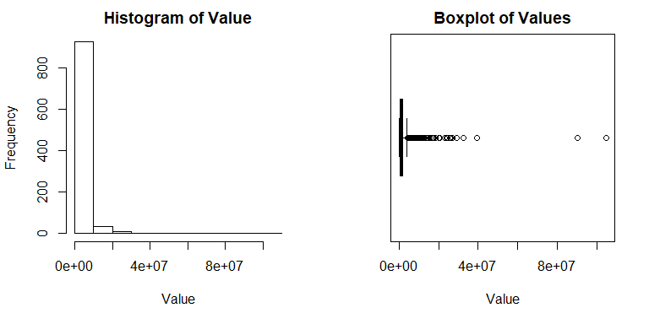
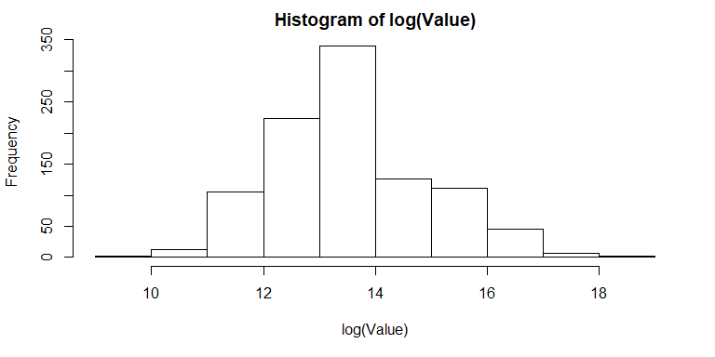
Histogram of Value vs Histogram of log(Value)
Distribution similar to the response variable.
Log transformation depicts a more symmetric distribution, close to normal.

Slide 6
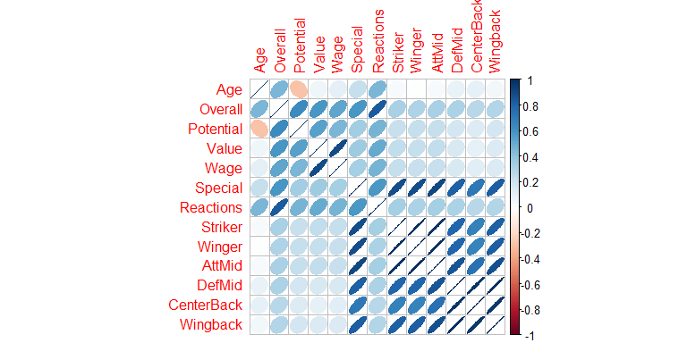
Correlations
The distribution of Wage is extremely right skewed therefore we thought a log transformation could resolve such issue.
We also did a log transformation on the predictor variable: Value.
The is a curvi-linear relationship between Wage and several other predictor variables: Age, Overall, Potential, Value etc.

Slide 7
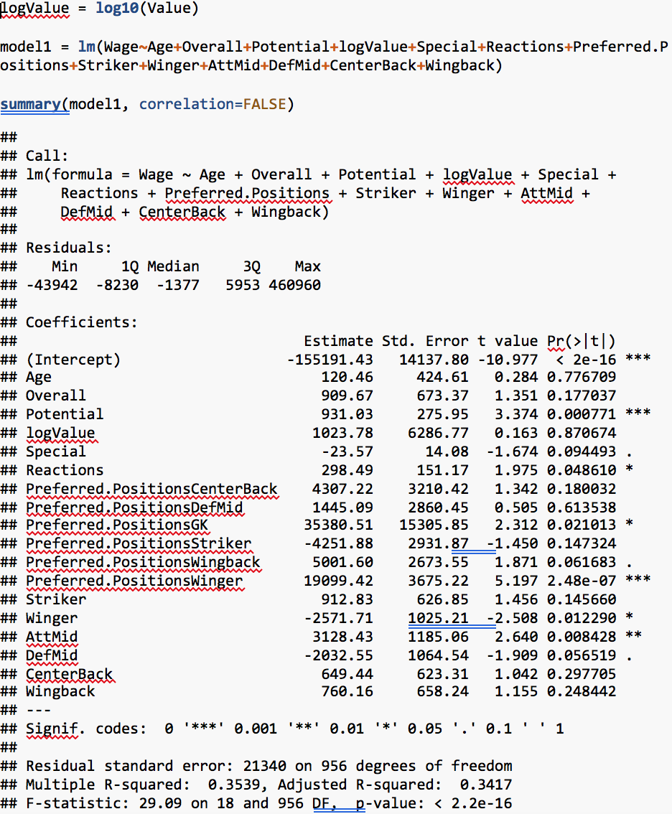
First Order Model
Response variable is Wage.
All predictors were included in the First-Order model.
Several predictors are not statistically significant.
Residual standard error is small given the range of Wages.
R² is of a low value.

Slide 8
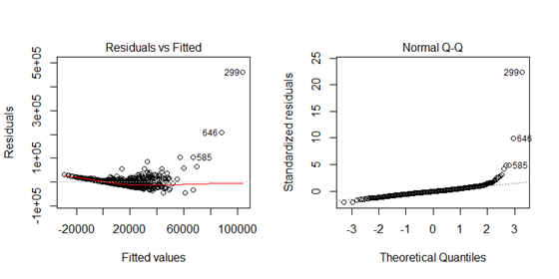
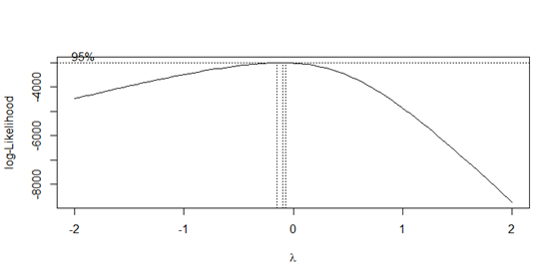
First Order-Model
Residual Analysis
Right skewness.
Curvi-linear relationship not being captured by the model.
Increasing variance with increasing Wages.
Several outliers.
Box-Cox Analysis
The Box-Cox analysis power transformation with lambda = -0.2.
Our log transformed model suggested better results than our first order-model.

Slide 9
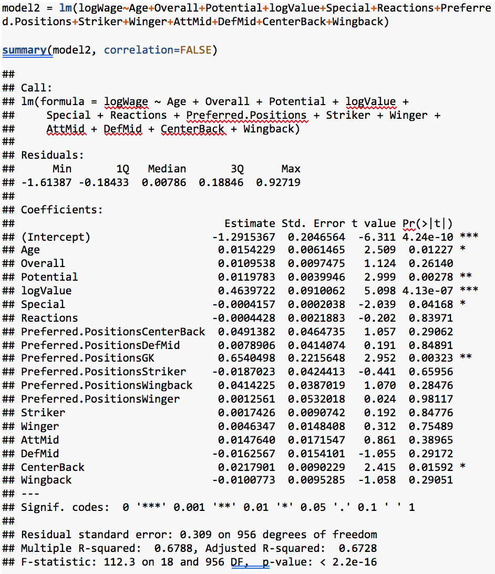
First Order-Model Log Wage
Response variable is Log Wage.
Several variables are not significant.
Adjusted R-squared is higher than in the first order model.
Residual standard error is low but it is in the log scale range.

Slide 10
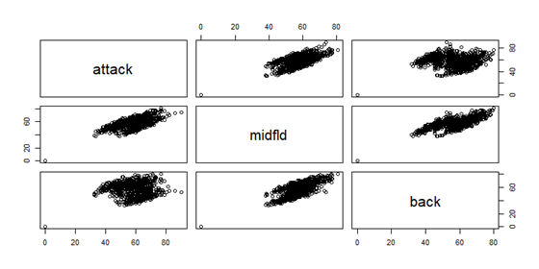
Grouping positions by areas of the field
Grouped positions by their corresponding areas of the field.
Note correlations between attack and back is less strong than attack/midfld and back/midfld.
Fitting the log transformed model with the positions grouped by areas of the field did not improve our results.

Slide 11
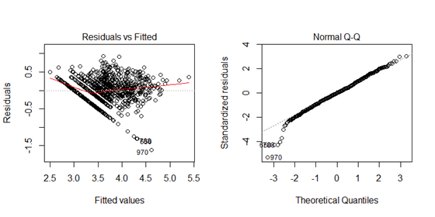
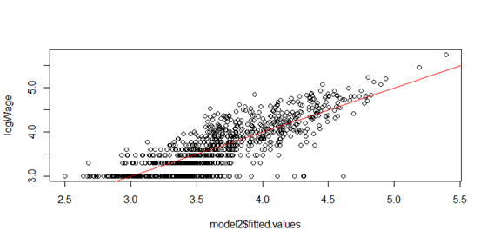
Log Transformed Model
Residuals Analysis
Residuals look much better with Log Wage as the response variable.
Residual variance is not normal.
Spreads for certain observed values.

Slide 12
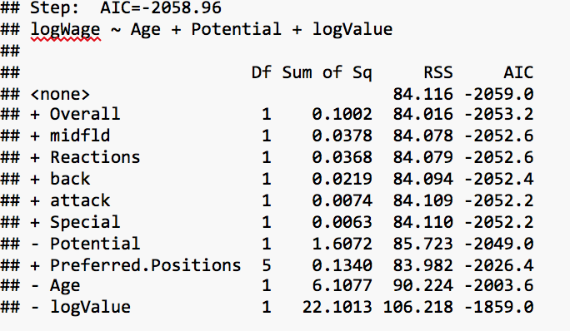
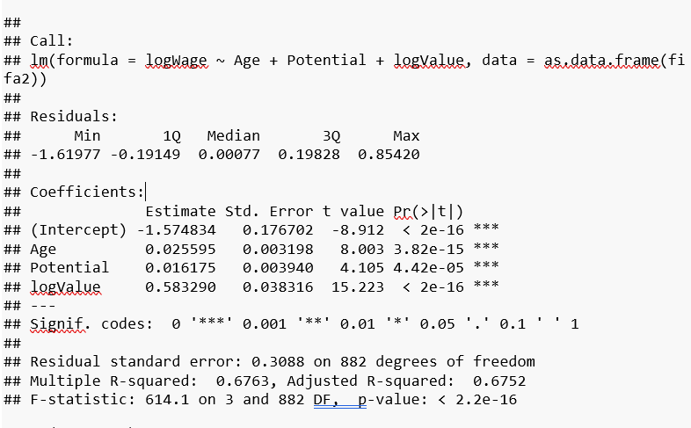
Stepwise Backward elimination Log Wage
Using the step function we did a backward elimination using the AIC criterion.
The best subset of predictors was:
Age
Potential
LogValue
R-squared lower than Log transformed first order model.

Slide 13
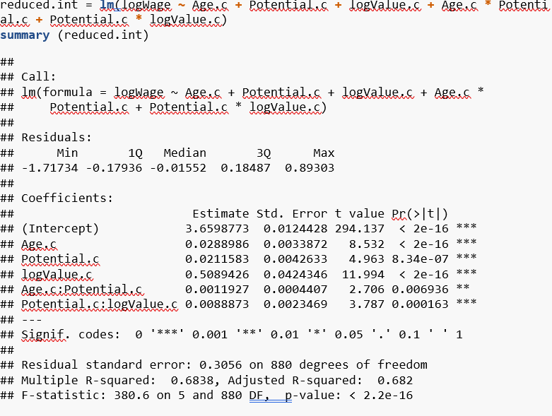
Final Model
Refit stepwise backward elimination model with interactions and took out least significant interaction.
(Potential.c:logValue.c)
R-squared better than all of our previous models.
All predictor variables are significant.

Slide 14
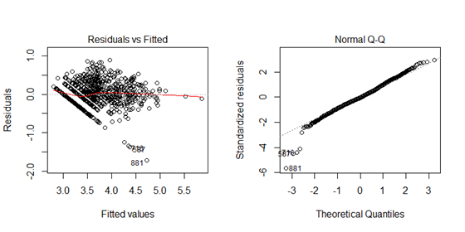
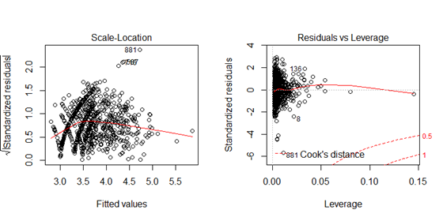
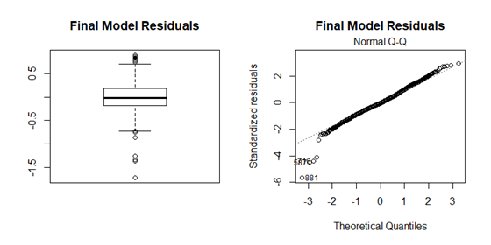
Final Model
Some patterns are still present.
Distribution looks more normal
Messi and Hazard had the highest leverage. Below the cut-0ff for cook’s distance.

Slide 15
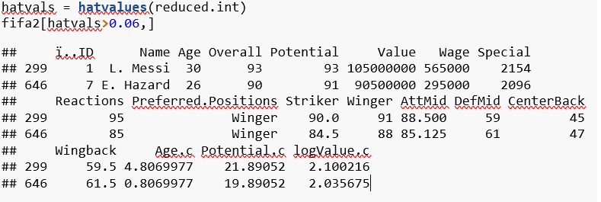
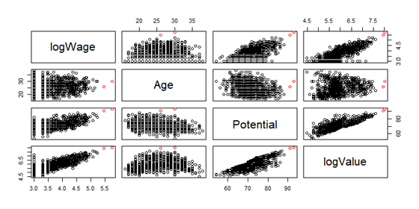
Messi and Eden Hazard

Slide 16
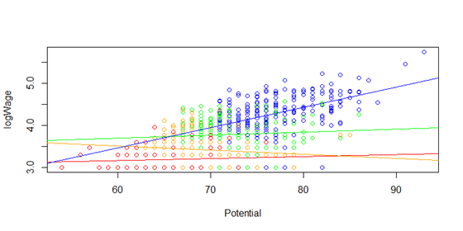
Final Model Interaction Effects
The LogWage vs Potential slope is the steepest for high value players and not steep for other value players.
Blue - Highest value players.
Green - Medium value players.
Orange - Medium/Low value players.
Red - Low value players.

Slide 17
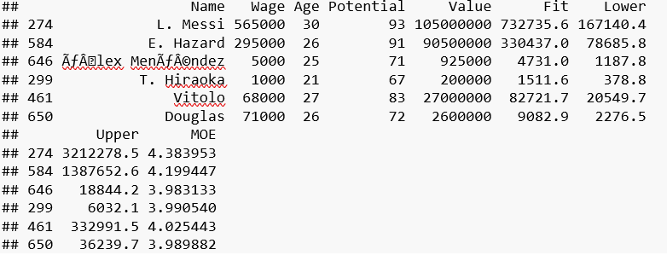
Final Model - Example Predictions
Prediction for Douglas does not contain the actual Wage value. We expect that 5% of the time, since we’re using a 95% confidence interval.
MOE is the biggest for high Wage players.
MOE is roughly close for all.

